Slide 1
Employee email privacy
Policies and Practices
Notes:
Related to email privacy at Wheaton

Slide 2
why is employee email privacy a concern?

Slide 3
“It is psychologically easier to self-disclose when no one is looking.”¹
Why is employee Email Privacy a concern?
Most employees don’t consider the issue
Have you ever read the student handbook?
Passwords
Lack of official legal practice in handling electronic mail privacy
¹ Weisband & Reinig, 1995
Notes:
Most employees don’t consider the issue
When was the last time you considered that someone else has access to your email records?
Do you assume your emails are private?
Have you ever read the student handbook?
What about Wheaton’s Acceptable Use of Technology Policy?
If you have read these, do you assume you’re immune?
Passwords
Some things, like passwords and identity verification (Google) create the illusion of privacy.
Lack of official legal practice in handling electronic mail privacy
Creating new laws surrounding technology has been largely avoided due to the ever-accelerating speed of technology growth.

Slide 4
is there a right to privacy to begin with?

Slide 5
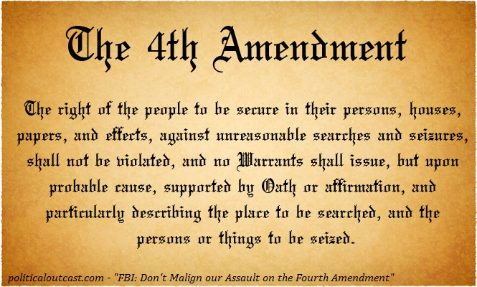
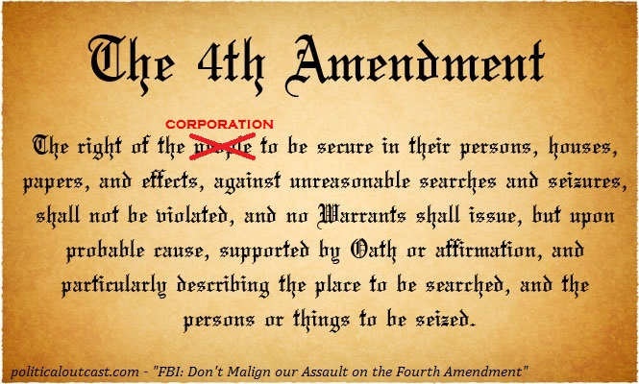
it depends on the employer
Is there a right to privacy to begin with?
Government Employers
Private Employers
Notes:
Corporations are people too…

Slide 6
The electronic communications privacy act of 1986
THE ECPA HAS 3 TITLES
The Wiretap Act
Prohibits any intentional interception, use, disclosure, or acquisition of any wire, oral, or electronic communication of any other person.
The Stored Communications Act
Protects the privacy of the files stored by service providers and of records held about the subscriber by service providers.
Pen Registers and Trap & Traces
Requires government persons to obtain a court order authorizing the instillation and use of a pen register and/or a trap and trace.
EXCEPTIONS
Title 1 provides exceptions for operators, service providers, and government officers.
SIGNIFICANT AMENDMENTS
CALEA (1994)
The USA PATRIOT ACT (2001)
Notes:
The ECPA updated the Federal Wiretap Act of 1968, which addressed interception of conversations using "hard" telephone lines, but did not apply to interception of computer and other digital and electronic communications.
The ECPA protects wire, oral, and electronic communications while those communications are being made, are in transit, and when they are stored on computers. The Act applies to email, telephone conversations, and data stored electronically.
EXCEPTIONS: Title I provides exceptions for operators and service providers for uses in the normal course of his employment while engaged in any activity which is a necessary incident to the rendition of his service and for persons authorized by law to intercept wire, oral, or electronic communications or to conduct electronic surveillance. It provides procedures for Federal, State, and other government officers to obtain judicial authorization for intercepting such communications, and regulates the use and disclosure of information obtained through authorized wiretapping. A judge may issue a warrant authorizing interception of communications for up to 30 days upon a showing of probable cause that the interception will reveal evidence that an individual is committing, has committed, or is about to commit a "particular offense“.
SIGNIFICANT AMENDMENTS
CALEA: The Communications Assistance to Law Enforcement Act of 1994 enhanced the ability of law enforcement agencies to conduct electronic surveillance by requiring that telecommunications carriers and manufacturers of telecommunications equipment modify and design their equipment and services to ensure that they have built-in surveillance capabilities, allowing federal agencies to wiretap any telephone traffic. It has since been extended to cover communication methods such as broadband internet.
The USA PATRIOT Act, clarifies and updates the ECPA to keep pace with the evolution of new communications technologies and methods, including easing restrictions on law enforcement access to stored communications in some cases.

Slide 7
What about employees of private companies?

Slide 8
policies
What about employees of private companies?
What do the employer’s policies say?
What does the employer do to carry out their policies?
Right-to-Monitor Policies
Hands-Off Policies
No Policy
Legal Interpretations
What have you heard?
Notes:
Right-to-Monitor Policies: Some organizations actively monitor the messages employees send to one another, maintaining that such access is necessary to properly administer the system.
“email is a company resource and is provided as a business communications tool. Employees with legitimate business purposes may need to view your email messages. It is also possible that others may view your messages inadvertently since there is no guarantee of privacy for any email message.” – Nordstrom Dept. Store Policy
Hands-Off Policies: Other organizations follow a hands-off policy, meaning they are supportive of their employees’ email privacy and do not access their electronic messages. This means there are few (if any) restrictions on communications content. But companies that take this approach may be liable when employees use improper or discriminatory language on the company network. Email Policies that support privacy cannot legally guarantee it.
No Policy: Most organizations have no formal or explicit policies regarding management’s access to email. If employees are unaware that email messages can be intercepted and read, they behave as if it were a private communications medium.
Legal Interpretations: Few employees know they can be held legally accountable for messages they send to others, as well as for messages they receive. Unlike telephone calls, email messages are treated as documents that, once retrieved, can be used as legal evidence.
What have you heard? In my experience, the only time I know of Wheaton Employees accessing the email accounts of other members in the community is when a figurehead of the college decides to step down from their position – President Crutcher.

Slide 9
“Electronic mail is a college resource and is provided as a college-related communications tool. It is possible that others may view your messages inadvertently. There is no guarantee of privacy for an electronic mail message.”
“Users are required to know and obey the specific policies established for the systems and networks they access. They have a responsibility to stay informed of changes and adapt as needed.”
“Violations of the Acceptable Use Policy will be treated as violations of the Honor Code and will be referred to the Dean of Students Office for disciplinary action. Prosecution under State and Federal laws may also apply.”
– Wheaton College Acceptable Use Policy

Slide 10
Why would an employer look into email account records anyway?

Slide 11
investigative interests (we hope)
why would an employer look into email account records anyway?
Investigating claims made against employees
Emails sent or received by an email account are flagged by a filter
Random Checks
Records Management

Slide 12
What can an employee do to protect themselves?

Slide 13
before an issue arises - preventative
What can an employee do to protect themselves?
Stay informed: read company policies
Discuss email privacy with the employer
“If you don’t want to see it in the morning paper, don’t put it in writing in the first place. The internet is for spreading information, not for keeping secrets.” – P. Rose
Notes:
Stay informed: read company policies
By keeping up with current technology policies, employees will know what practices are acceptable in the workplace.
Discuss email privacy with the employer
This will give the employee a sense of the actual practices the company uses.

Slide 14
after an issue arises - reactive
What can an employee do to protect themselves?
The Reasonable Expectation of Privacy Test
1. Can the employee show that they had reason to believe their email was private?
2. Did the employer have a sufficient reason for performing the search?
Notes:
Originated from Katz v. United States
Evidence brought against Katz was obtained by the FBI by using a wiretap on a public phone booth Katz was using without first obtaining a warrant.
Katz proved he had a reasonable expectation of privacy privacy because the telephone booth was public and there were no postings informing users that it was under surveillance.
It was determined that placing a wiretap on a public phone booth without a warrant is a violation of the 4th amendment because it is an unreasonable search of private property.
(The Original Wiretap Act only applied to recordings of human voices, but the ECPA has updated it to include email and electronically stored data.)

Slide 15
bibliography
Weisband, S. P., & Reinig, B. A. (1995, December). Managing User Perceptions of Email Privacy. Communications of the ACM, 38(12), pp. 40-47.
Wheaton College. (n.d.). Student Acceptable Use Policy. Retrieved March 2015, from wheatoncollege.edu.

